Slide 1
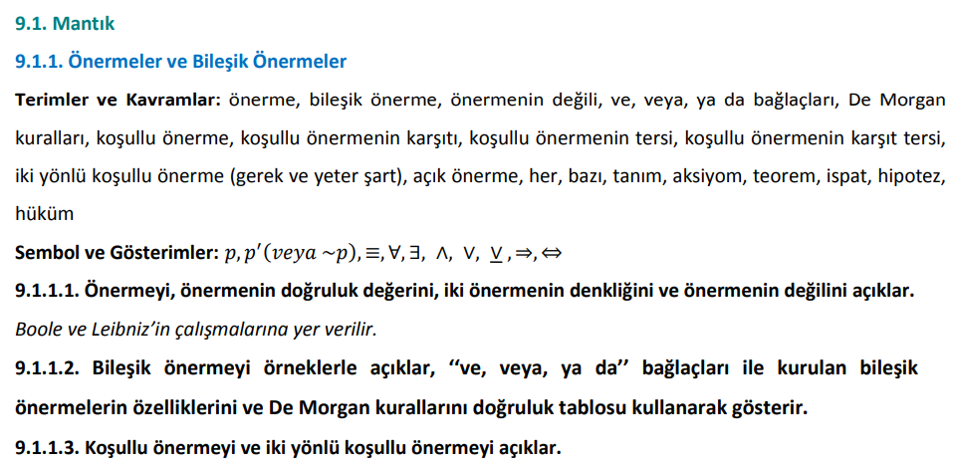
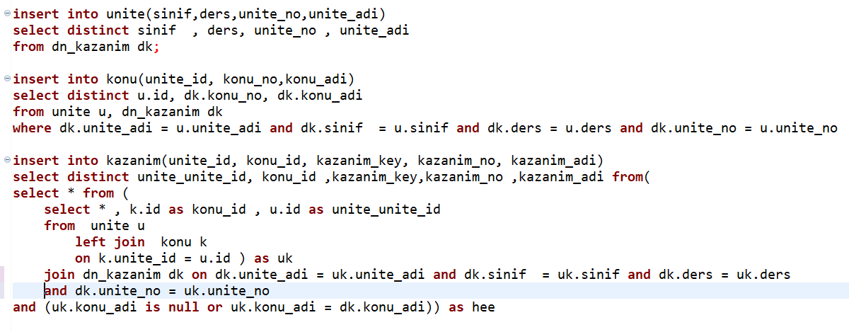
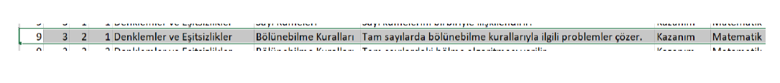
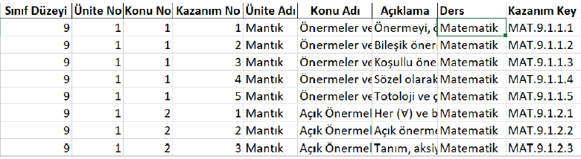
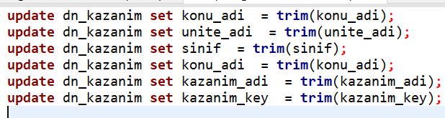
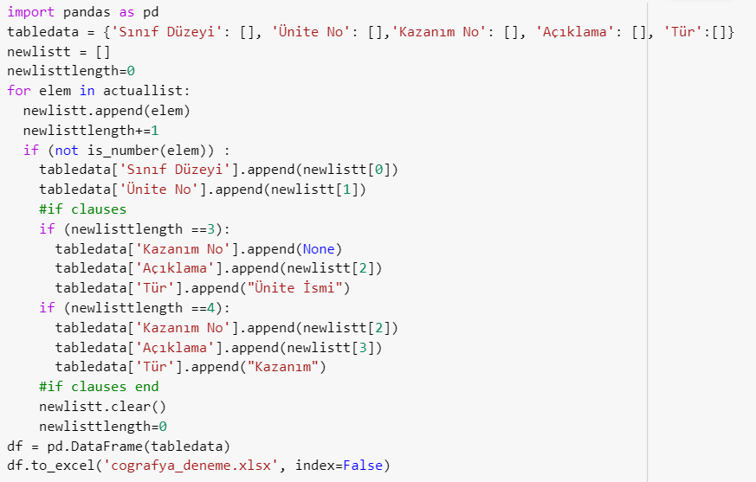
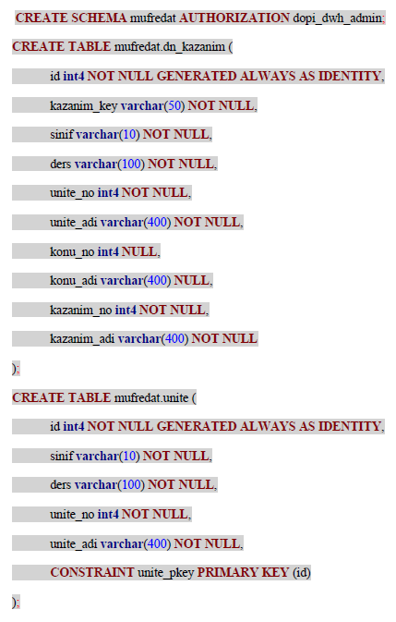
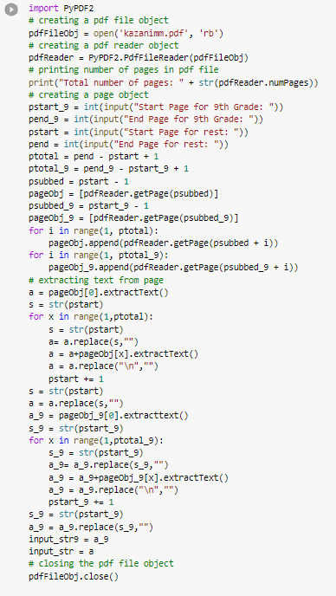
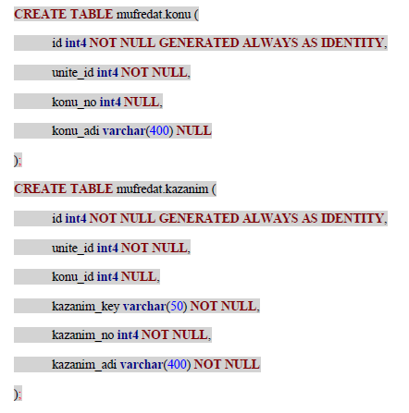
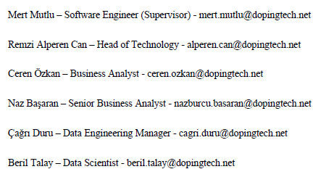


Online Education Transformation Project at Doping Technology
Göktuğ Gençkaya
CS395 Summer Internship Poster
INTRODUCTION
Materials & Methods
Results
Conclusions
Doping Technology is a company that has been in the market since 2011. They first got into market with their first product ‘Doping Hafıza’ which is an online education platform that offers educational materials in a fun way and facilitates learning my memory techniques. In time they created more products and develop ‘Doping Hafıza’ every year. This year they decided to have a transformation project on this first product so that they it will look like a brand-new platform and work more efficiently with newer technologies. Within the scope of this project, questions that are already been asked in the platform should be connected to learning objectives. Learning objectives are short descriptions of outcomes of each lesson which are published in MEB’s website every year. Moreover, since they have a cumulated and messy database, new database should be created and all content from the old database should be migrated to new database. Last but not least, user interface will be changed and developer technologies, coding programs will all be changed. As an intern, we were given the task to get those learning objectives from the website and put them to the database in proper structure. Furthermore, we also helped with the migration of old database. Other than that, we had learning tasks on clean code, Java, multiservice architecture, SQL and Python. ‘Online Education Transformation’ didn’t finish during the time I had my internship but we had a great start and everything happened just in time. It went really beneficial for me to learn theoretically and practically.
For the purpose of capturing the objectives, I thought that Python would solve this problem easier than any other programming language. As we already used in the university lectures, I prefer t work on Google Colab to run python programs. I only needed PyPDF2 and pandas libraries for all of them. For some LO documents I also use re library. Additionally, to connect Python with PostGres database, I had to use psycop2 library functions.
Our data engineering manager Çağrı created a postgres database as a new database of company. All the information that old database contain had to be migrated to this new database. To get the data from old database and create a new database and have some amount of manipulation on imported data, we had to write SQL queries.
On the software part, they were using Java most of the time. None of the interns had great experience with Java coding. Thus, they wanted us to learn Java independently. At the times where we don’t have any task assigned to us, we try to learn Java using different websites such as HackerRank, Codeacademy etc. As the end of the intern was approaching, we weren’t able to have a hands on experience with Java. Our supervisor hadn’t assign any tasks on Java.
‘Online Education Transformation’ project started at the same time with my internship. It was planned to fully complete in May. It was the biggest project that company was currently working on but it was not the only project. Also it encompasses creating a education platform from scratch which means that engineers had to create the same but improved ‘Doping Hafıza’ program that have been developing since 2011. All the cumulative labor were to be done again within a year. Thus, project hadn’t been completed when my internship ended. On the other hand, almost all the parts and task that were assigned to me were done. Learning objectives were downloaded from the MEB’s website and put into Excel tables in desired format. New database is created and these objectives were then imported into this new database. As for the simplicity and practicability of the DB, we also created different tables for units, topics. For migrating old questions into the new database, I created an old questions table in new database. With the help of the SQL query that unifies all questions that were spread over the old database, using ‘UNION ALL’ statements, we exported the table with all existing questions and import it back to the new database. Unfortunately, we had to singularize all the questions since there were multiple versions of same question in the database. We weren’t able to come up with a solution to that singularization problem although we were able to get a hash code for all questions with md5() function of SQL. In continuation of the ‘Online Education Transformation’ project, all of these learning objectives will be connected to questions. This task will be done by instructor working at Doping Technology but engineers will create a recommendation, suggestion pool of learning objectives per question by some Natural Language Processing utilities. Project is planned to be completed in May, so that it can be put on the market for June, July for the upcoming education semester.
In summary, my internship experience contains both learning new things and experience to implement this new knowledge and develop my existing skills and having experience with these skills. We started with learning about multiservice and monolithic architecture. Our first task was to get the learning objectives from the curriculum. With the help of Python, I wrote several programs to output these learning objectives in a desired table format. Then with these Excel tables, we opened a new database and imported these tables. With the help of SQL queries, we also created different tables and did some little modifications of raw data. Moreover we unify the questions and videos in the old database which is too messy and is needed to be properly collect up. We also imported these old questions to a newly made table in new database. Besides of these, we learn about new technologies and tools, study some theatrical stuff, work on Java programming. In school, I used to think that I am not a good developer and I didn’t believe that I will ever become a good developer or a coder. I had many doubts about becoming a software engineer as I don’t think I will be able to spend that much time for programming. I couldn’t find motivation to improve myself. During the internship, I had time and motivation to study for myself and get a chance to develop myself. Having this leisure time, getting to see how a project is implemented in a broader view made me see that I can develop myself in a much greater scale. In time, when I get more familiar with the programs, I get the sense that I know what I am doing and the feeling of usefulness becomes very fulfilling. Programming and coding takes too much time to practice and I started to enjoy this time eventually.
Objectives
References
Every year MEB, ministry of education, publishes a curriculum for each lesson and for every grade. These curriculum documents involves a collection of learning objectives. Learning objectives are couple of sentences that summarizes the information that has to be transferred to students in an understandable form. For example, for Math lesson, one of the most important 9th grade topic is divisibility rules. One learning objective of this topic is “Students are able to solve problems about divisibility rules with integers.” Curriculum cannot involve any more information than these objectives. Thus, any question that is asked in the examination should be able to solve-able by this cumulative information in learning objectives.
One of the main aims of the transformation project was to capture these learning objectives and match each question to one or more objective. This way, system will be able to understand the inadequacy of students. To elaborate more on that, if a specific student had a mistake on a question within the system, system would learn that that question lacks the information contained in learning objective that is connected to that question. By establishing the missing knowledge of student, system could offer topic description videos or direct user to study more on those topics. After that system should be able to ask different questions that are also connected to the same LO that user lacks. This way, that LO would marked as learned.
Company had an enormous database having different questions, different solution videos, users information and many more. We have to carry all the old information from old database to newly created database. In other words, there was a migration from old database to new database. Furthermore, some rows of data can be duplicated, some questions could be entered multiple times to the system. So one another task was to clean the already existing data.
Raman_257 (2022). Monolithic vs Microservices architecture. Geeksforgeeks. Retrieved September 30, 2022, from https://www.geeksforgeeks.org/monolithic-vs-microservices-architecture/
Gnatyk R. (2018). Microservices vs Monolith: which architecture is the best choice for your business? N-ix. Retrieved September 30, 2022, from https://www.n-ix.com/microservices-vs-monolith-which-architecture-best-choice-your-business/
select ats.id as Table_id,
'Akilli Test Sorulari' as Table_name,
ats.uniteid as unit_id,
ats.konuId as konu_id,
ats.testid as test_id,
ats.video as solution_video_id,
ats.sira as 'Order',
ats.soru as 'Content'
from akilli_test_sorular ats
union all
select tats.id as Table_id,
'Tarih Akilli Test Sorulari' as Table_name,
tats.uniteid as unit_id,
tats.konuId as konu_id,
tats.testid as test_id,
tats.video as solution_video_id,
tats.sira as 'Order',
tats.soru as 'Content'
from tarih_akilli_test_sorular tats
union all
select tts.id as Table_id,
'Tarih Testi Soruları' as Table_name,
'-' as unit_id,
'-' as konu_id,
'-' as test_id,
tts.video as solution_video_id,
'-' as 'Order',
tts.soru as 'Content'
from tarih_test_soru tts
union all
select
ts.id as Table_id,
'Test_soru' as Table_name,
'-' as unit_id,
'-' as konu_id,
ts.testId as test_id,
ts.video as solution_video_id,
'-' as 'Order',
ts.soru as 'Content'
from test_soru ts
union all
select
ds.id as Table_id,
'deneme_soru' as Table_name,
'-' as unit_id,
'-' as konu_id,
ds.testId as test_id,
ds.video as solution_video_id,
ds.sira as 'Order',
ds.soru as 'Content'
from deneme_soru ds
union all
select
mts.id as Table_id,
'math_test_sorular' as Table_name,
mts.uniteId as unit_id,
mts.konuId as konu_id,
mts.testId as test_id,
mts.video as solution_video_id,
mts.sira as 'Order',
mts.soru as 'Content'
from math_test_sorular mts
union all
select
rtts.id as Table_id,
'rt_test_sorular' as Table_name,
rtts.uniteId as unit_id,
rtts.konuId as konu_id,
rtts.testId as test_id,
rtts.video as solution_video_id,
rtts.sira as 'Order',
rtts.soru as 'Content'
from rt_test_sorular rtts
union all
select
rfts.id as Table_id,
'rfen_test_sorular' as Table_name,
rfts.uniteId as unit_id,
rfts.konuId as konu_id,
rfts.testId as test_id,
rfts.video as solution_video_id,
rfts.sira as 'Order',
rfts.soru as 'Content'
from rfen_test_sorular rfts
Recommendations
I think every person has different routines for working. Working from 8 AM to 6 PM might not be very effective for everyone. Some people would benefit from working at nights or working task based rather than strict employment periods. It is important for oneself to know what is working with them to work much more efficiently. This also applies to having a remote, hybrid or a face-to-face internship. I recommend that students will choose their internship according to their desired life-style.
Secondly, I used to think that it’s not a good thing to ask questions to my supervisor. I don’t want anyone to think that I am less qualified than I actually am. I was afraid if my questions cause company to think that I am not adequate. I was wrong about this since asking questions demonstrate the enthusiasm and eagerness to learn. When I get to discuss my problems with other engineers, my work and my knowledge became more visible. My suggestion is that no one should hesitate to ask questions to their supervisor.
Last of all, I recommend people to do their internship at comparably little companies. In Doping Technology, there was a really dynamic environment. There were no strict job descriptions so I get to learn about every process that company has been going through. I get so see different engineers’ work although I was a Back End Intern. In more organized and big companies, everything is settled and you would probably have limited access to many things.
Contact

